Slide 1
The Traveling Sideshow

Slide 2
Data Science @ HCA
It’s Science!

Slide 3
Above all else, we are committed to the care and improvement of human life. In recognition of this commitment, we strive to deliver high quality, cost effective healthcare in the communities we serve.

Slide 4
The Mission of Data Science
We strive to further the care and improvement of human life through the power of data.
Data and
Data Science are
key components in
the fulfillment of
HCA’s mission.

Slide 5
What is Data Science?
Data science is the set of techniques and technologies that use data and analytics to drive optimal actions in the real world.
- Edmund

Slide 6
Moving from descriptive analysis to prescriptive actions
Data
Prescriptive
What we will do? (Automate)
Actions
Prescriptive
What should we do? (Recommend)
Decisions
Predictive
What is going to happen?
5%
Diagnostic
Why did it happen?
10%
Descriptive
What Happened?
80%
Analytics
Human Input

Slide 7
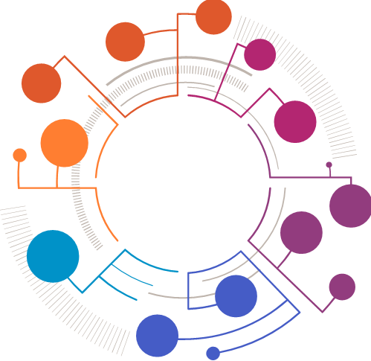



The Data are Worthless
Data has no intrinsic value; only actions have value.
Data Science is the ‘distillation’ of data into optimal actions
DATA

Slide 8
The Data Science “Process”
The World
Data
Science / Math
Code
Tech
The World
Actions occur in the world and are measured, captured and stored in databases.
Data are analyzed with mathematics and machine learning to find patterns.
This is the learning, (or training) process for models.
Patterns are captured as software algorithms.
Algorithms execute in realtime on fast computers and networks.
This is called scoring.
The output suggest actions to humans or drive autonomous technology, changing the real world
Notes:
Need to HCA brand wash

Slide 9

The Math
Statistical Analysis
Machine Learning
Natural Language Processing
Artificial Intelligence
Traditional, effective methods for describing data sets along with trending
Useful for analyzing the past in aggregate
Gaussian, Binomial, Lognormal, Exponential
Methods for finding patterns in data
Useful for finding expectations of individuals based on the past
Regression, Decision Trees, Classification, Clustering, Collaborative Filtering
A subject area of data science for encoding and numerically describing human language
Machine Learning layered on to NLP to build models
Vector Models, Sentiment Analysis, Search Engines
Attempts to mimic human capabilities in solving non-linear problems
Neural Networks
Speech Recognition, Imaging, Advanced Recommendation Engines

Slide 10



The Code
Data Collection
Model Algorithm
Signal Delivery
Front End
Collection, processing, monitoring, storage, and delivery of historical and real-time data to models from the world
Traditional ETL and data analysis
The math and theory of a model embodied in an algorithm that makes a prediction (or signal) with information to act on
HCA is a Python 3 shop
Storage, dissemination, and monitoring of the results from a model back into the world
Methods include database landings and APIs
Integration of signals into real-world workflow that enable decision making and action
Often through existing applications, but occasional custom GUIs

Slide 11


The Tech
Servers & Cloud
Network & Security
Desktop Access
Mobile Devices
Reliable, flexible, and scalable platform built on fully supported enterprise systems
Openshift, Azure
Teradata, Hadoop
Connecting and securing data across systems and locations
Encryption, authentication and validation protocols
Applications that collect, send, and receive data
Consumes model signals for actionable workflow
Tableau, PowerBI, Custom Web Interfaces, Patient Keeper
Applications that collect, send, and receive data
Consumes model signals for actionable workflow
Raven, iMobile, Custom Apps, Web Dev

Slide 12



Data Science is More than Code
Science & Math
Art & Communication
Algorithms
Scientific Method (Hypothesis, Test, Repeat)
Heavy reliance on statistics
Deep understanding of the variety of models, their uses, and their shortfalls
Ability to interpret results precisely and accurately
Visual design for infographics and dashboards
Distill models into actionable and useful results
Models without influence or action are worthless
Tools of the trade
Convert the math and model concepts into an executable code
Heavy on programming
Developer type skillset

Slide 13

Our Team
We are charged with
Building data science capabilities and coordinating efforts across the enterprise
Developing models that improve how HCA operates and delivers care
Creating new approaches to solving technical challenges along the way
Our mission squarely aligns with solving some of the hardest challenges in our healthcare settings
We are neither an IT team, nor clinical team
We consist of data scientists, analysts, and engineers from diverse backgrounds and experiences.
Dr. Edmund Jackson
VP & Chief Data Scientist
Click Here
Notes:
https://www.youtube.com/watch?v=6-r9srBN8jM

Slide 14
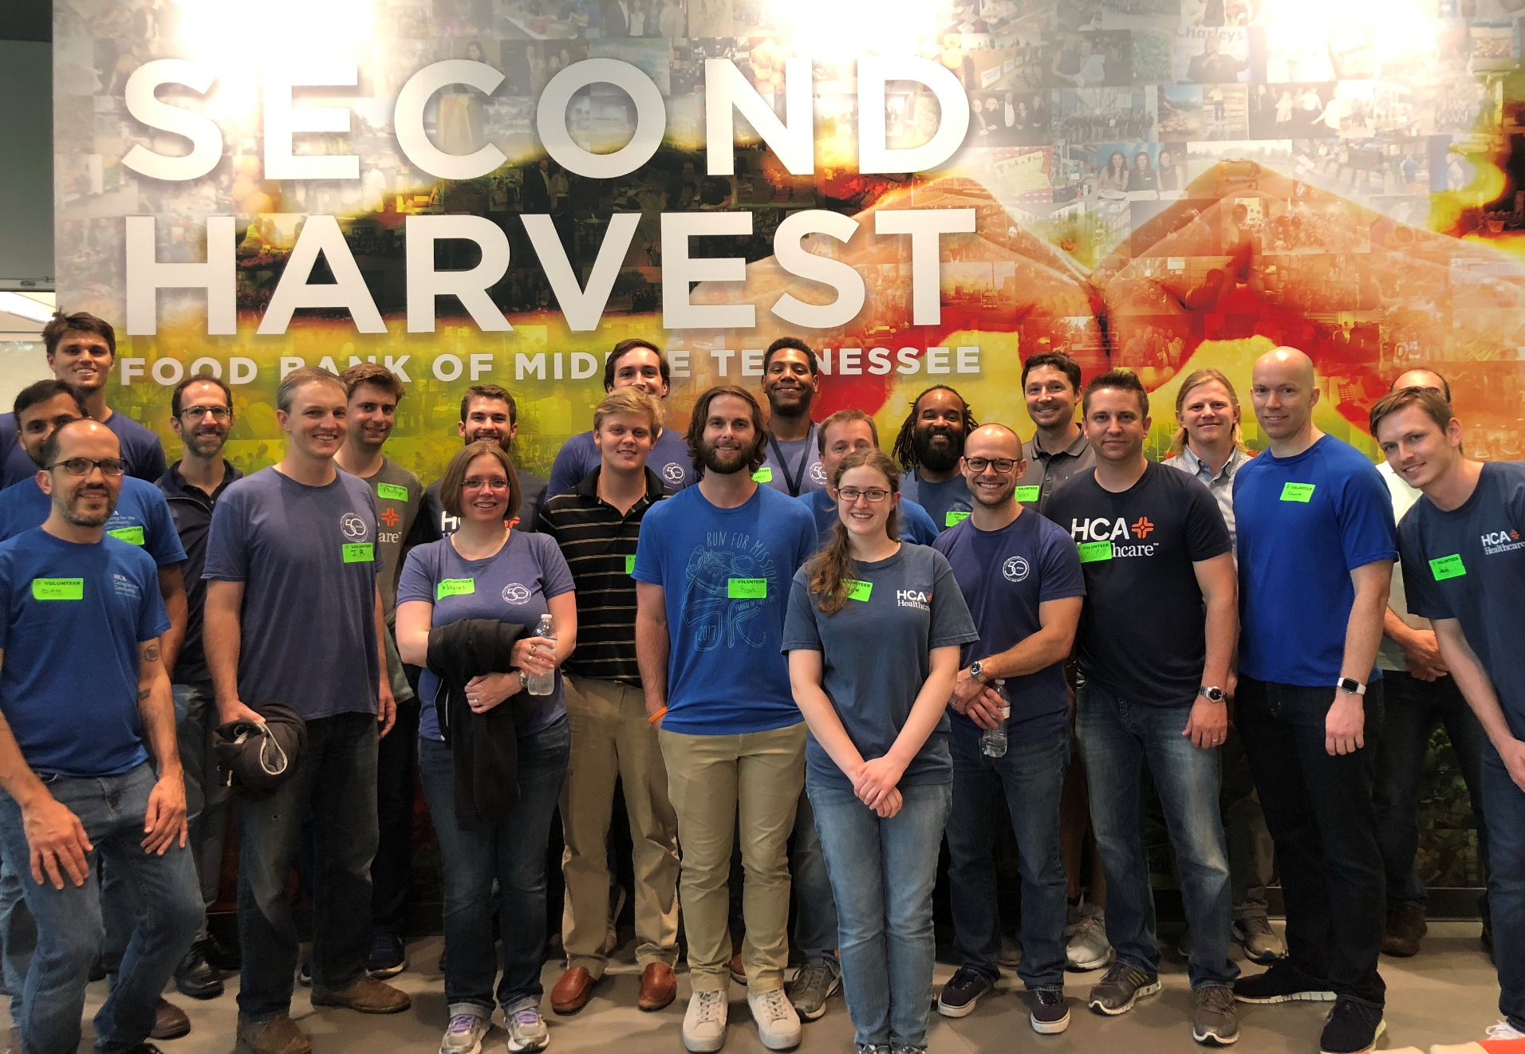

Slide 15



Our Products
Clinical Outcomes
Healthcare Operations
Care Coordination
SPOT (Sepsis)
ICU Predictor
Ventilator Models
NATE (Visibility & Throughput)
Surgical Service Models
ER Census Predictor
Discharge Predictor
Readmissions Predictor (REX)
BPCI Patient ID Models
ER Callback Model
DRG Family Predictor

Slide 16

Sepsis Prevention & Optimization of Therapy
Q4 2018 vs Q4 2017
5% raw mortality reduction, 12% overall (41.2% → 36.2%)
140 more patients with 51 less deaths
Existing workflow required nurses to manually screen for sepsis every 12 hours, but sepsis can appear any time of the day
With severe Sepsis, mortality rates increase 4 – 7% every hours without treatment
New clinical information on patients is continuously collected from HL7 streams
SPOT analyzes the data real time as new information comes in and alerts clinicians when it detects signs of sepsis in a patient
Oct 2017 – SPOT Rollout Begins
Aug 2018 – 1,000,000th “customer”
Oct 2018 – SPOT Live In Every Hospital **
Nov 2018 – Dr. Perlin testimony to US Senate
May 2019 – 2019 Red Hat Innovator of the Year
Click Here
Notes:
https://www.redhat.com/en/success-stories/innovation-awards
https://spot.medcity.net/

Slide 17
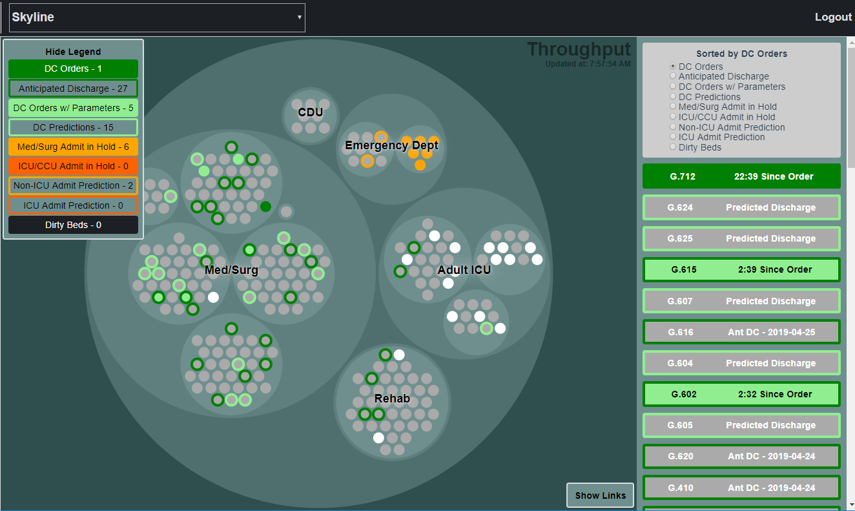

Next-gen Analytics for Treatment & Efficiency
Enterprise platform for delivering timely data from nearly any source
Visual representation of the hospital
Fast, reliable, easy to use with customizable overlays for different data and model signals
Example Signals:
Bed Status / Discharge Order Status w/ Barriers
ED Disposition Predictor (CSG)
Discharge Predictor (CSG)
Readmissions Predictor (CSG – TREX)
Infection Prevention (CAUTI/CLABSI)
Census & Risk Logic (Emergency Preparedness)

Slide 18
Current State - Product Lifecycle & Development
Initiation
Ideation
Exploration & Modeling
PoC Build
Innovation Review
PoC Field Test
Initiate discussions around a product and project idea as well as the initial scope
Scope and refine an idea that has been formally accepted as a project
Explore the data and develop a model as the basis for a proof of concept
Develop and build a minimally viable product as a proof of concept for field testing model
Test and refine the proof of concept with select sites and end-users
Analyze and review the results from the proof of concept in preparation for an enterprise solution
Innovation Stage
Analysis & Design
Development
Pilot & Refinement
Enterprise Deployment
Handoff & LTS
Prepare an idea that has been proven in concept to be developed as an enterprise solution
Develop and build an enterprise grade product to be piloted
Test and refine the product iteratively with participating end-users
Deploy the product across the enterprise as led by the product owner and supported by the DS team
Hand off the completed product to the product owner and long term support team
Enterprise Stage

Slide 19
Future State – Build at Scale to Start
Initiation
Ideation
Exploration &
Modeling
Pilot
Development
Pilot Test &
Refinement
Innovation Stage
Initiate discussions around a product and project idea as well as the initial scope
Scope and refine an idea that has been formally accepted as a project
Explore the data and develop a model as the basis for a pilot
Develop and build an minimally viable, enterprise grade product as a pilot for field testing model
Test and refine the product with select sites and end-users
Innovation Review &
Enterprise Readiness
Assessment
Enterprise Planning &
Refinement
Enterprise Deployment
Handoff &
Long Term Support
Enterprise Stage
Analyze and review the results from the pilot in preparation for an enterprise deployment
Update product based on review and plan enterprise implementation
Deploy the product across the enterprise as led by the product owner and supported by the data science team
Hand off completed product to the product owner and long term support team

Slide 20



The Future
Enterprise Data Science Platforms
Machine Data (IoT)
Enterprise Data Strategy & Governance
Central location to access to access model signals
Eliminate the need to create custom apps and dashboards
Develop and integrate APIs
Repeatable Frameworks
Access and use data emitted by clinical devices
Real time feeds and monitoring of patients without the need for manual data entry
Enable analytics at scale, and faster development
We have a lot of data, but it’s messy and siloed for specific uses
Core Data
Core Analytics
Notes:
https://nate.medcity.net/COCBR

Slide 21
The Shameless Pitch
Interested in learning more about data science or learning the tools of the trade?
Let us know!
Matthew.Brown@HCAHealthcare.com

Slide 22


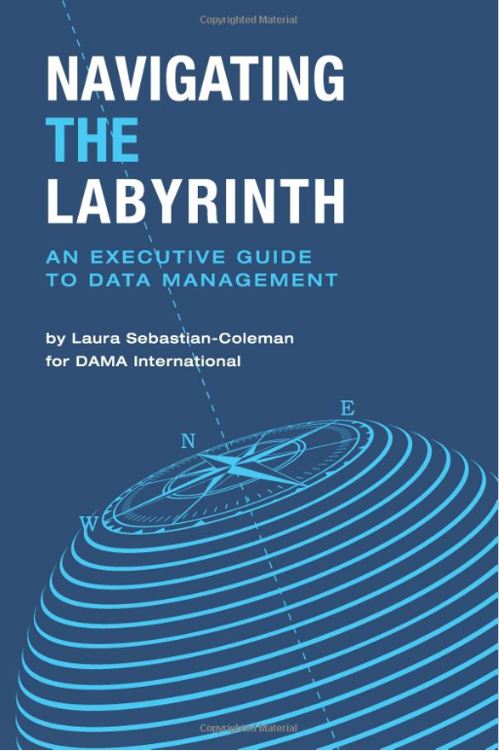
Holiday Reading Recommendations

